Slide 1
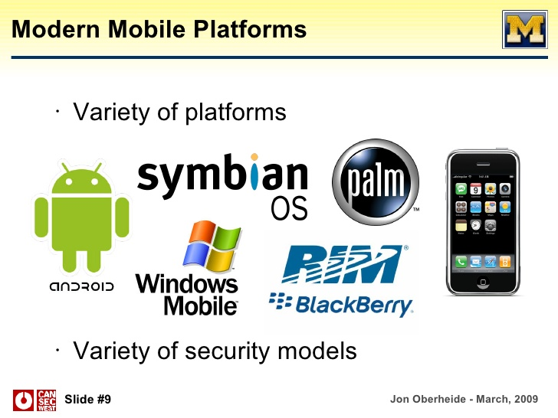
Mobile Security Models Comparison Report student’s Name
Institutional Affiliation

Slide 2
Mobile security models
Recently, there has been an increased use of mobile phones and personal computer.
Smartphones and computer are the significant targets of attack by malicious people in obtaining personal or business information
Advanced technology has made it easy for individuals with ill motives to interfere with the users’ privacy.
Android and iOS are among the firms that have developed security measures to deal with the increased level of threats.
Development of software and systems in the determine the level of security assured to users.

Slide 3
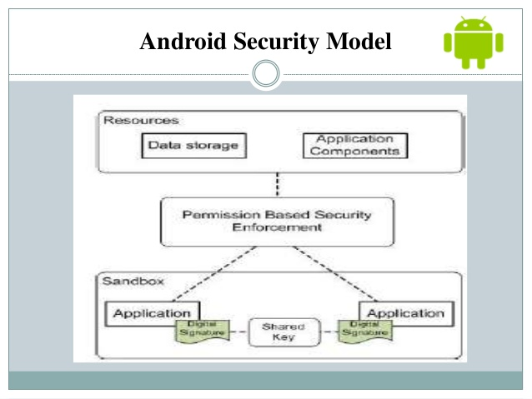
Security models for Android
The model takes the trust boundary as one application.
The model provides a means for interaction between the user, hardware and the installed applications.
To prevent unauthorized access, a concept of code signing is provided.
Android provides its applications to users through Google Play, which is the most trusted source (Acar et al., 2016, p433).
The model offers privacy for its applications through encryption.

Slide 4
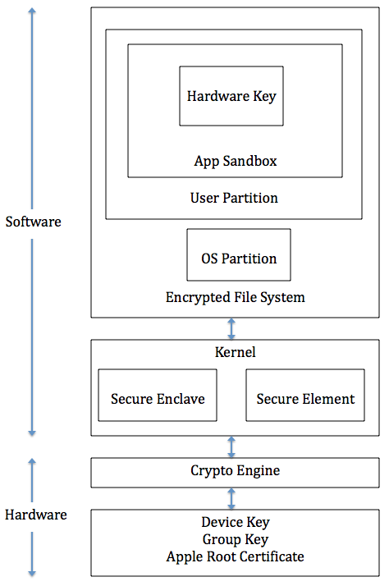
Security models for iOS
Security design for mobile devices is provided at hardware, OS and application levels.
Encryption is required from the hardware level
Applications are sandboxed
The systems protect personal data is using encryption (Fernandes et al., 2017, p24).
Code signing is done to confirm the security of codes.
.

Slide 5
Comparison of the security models
Applications in both Android and ios are sandboxed to separate running programs.
Code signing is done in both types of devices through cryptography for integrity purposes.
Both ios and Android support encryption systems
Both models use similar security criteria in preventing both local and web attacks (Fernandes et al., 2017).

Slide 6
Differences between the security models
In ios, nearly all applications run under the same username, while Android’s applications have different users.
System developers use Java language to write Android applications, while ios use Objective C language in its applications (Sadegh et al., 2015, p3).
Ios offers active centralized device management while Android does not provide such services

Slide 7
Summary
Both Android and ios security models have benefits and limitations.
Most people do not consider security features when purchasing smartphones.
Android and ios are in a competitive market. Therefore they keep upgrading their models (Sadeghi et al., 2015).
Users should ensure that the devices they use offer a quick response to security threats.
Both ios and Android can be equally secure if developers use appropriate security requirements.

Slide 8
References
Sadeghi, A. R., Wachsmann, C., & Waidner, M. (2015, June). Security and privacy challenges in industrial internet of things. In 2015 52nd ACM/EDAC/IEEE Design Automation Conference (DAC) (pp. 1-6). IEEE.
Acar, Y., Backes, M., Bugiel, S., Fahl, S., McDaniel, P., & Smith, M. (2016, May). Sok: Lessons learned from android security research for appified software platforms. In 2016 IEEE Symposium on Security and Privacy (SP) (pp. 433-451). IEEE.
Fernandes, E., Rahmati, A., Jung, J., & Prakash, A. (2017). Security implications of permission models in smart-home application frameworks. IEEE Security & Privacy, 15(2), 24-30.

